Slide 1
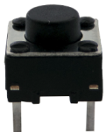
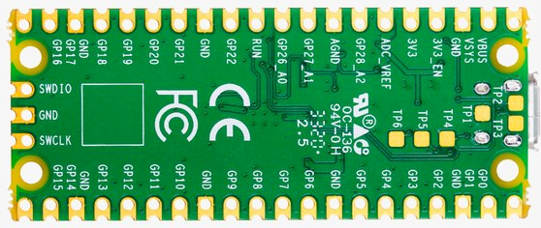
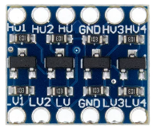



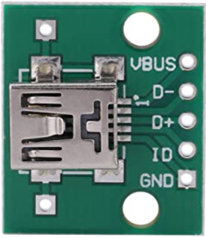
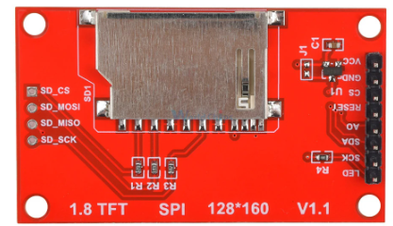
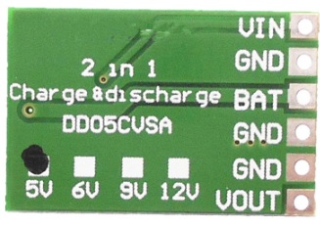
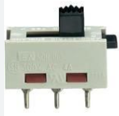
MODE
HDR
BORDER
REBOOT
CAM_VOUT
CAM_GND
SD_MISO
CAM_VCC
SD_CS
SD_MOSI
+3.3V
SD_SCK
FREE
FREE
FREE
CAM_READ
CAM_CLOCK
Access to SD card
CAM_RESET
Exposure time
CAM_LOAD
CAM_SIN
CAM_START
READ
CS
SDA
SCK
CLOCK
RESET
A0
FREE
FREE
SIN
LOAD
RESET
reserved
reserved
FREE
FREE
START
+5V
Batt+
Batt-

Slide 2
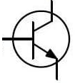
Idle/record
Dither
Border
REBOOT
HDR
CAM_VOUT
CAM_GND
SD_MISO
CAM_VCC
SD_CS
SD_MOSI
+3.3V
SD_SCK
FREE
FREE
CAM_READ
CAM_CLOCK
Access to SD card
CAM_RESET
Exposure time
CAM_LOAD
CAM_SIN
CAM_START
READ
CS
SDA
SCK
FREE
LED
CLOCK
RESET
A0
FREE
FREE
SIN
LOAD
RESET
FREE
FREE
START
+5V
B
Batt+
C
E
2N2222
Batt-

Slide 3
Idle/record
Dither
TL/C
REBOOT
HDR
CAM_VOUT
CAM_GND
SD_MISO
CAM_VCC
SD_CS
SD_MOSI
+3.3V
SD_SCK
FREE
FREE
CAM_READ
CAM_CLOCK
Access to SD card
CAM_RESET
Exposure time
CAM_LOAD
CAM_SIN
CAM_START
READ
CS
SDA
SCK
FREE
FREE
CLOCK
RESET
A0
FREE
FREE
SIN
LOAD
RESET
FREE
FREE
START
+5V
Display ON/OFF
Batt+
Batt-

Slide 4
LOCK
Dither
TL/C
REBOOT
Record
HDR
CAM_VOUT
CAM_GND
SD_MISO
CAM_VCC
SD_CS
SD_MOSI
+3.3V
SD_SCK
FREE
FREE
CAM_READ
CAM_CLOCK
Access to SD card
CAM_RESET
Exposure time
CAM_LOAD
CAM_SIN
CAM_START
READ
RESET
CS
SDA
SCK
FREE
SIN
CLOCK
A0
FREE
LOAD
RESET
FREE
FREE
FREE
START
+5V
Display ON/OFF
Main ON/OFF
Batt+
Batt-

Slide 5
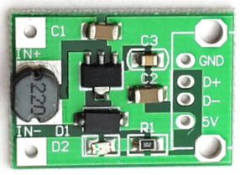
LOCK
Dither
REBOOT
Record
HDR
CAM_VOUT
CAM_GND
SD_MISO
CAM_VCC
SD_CS
SD_MOSI
+3.3V
SD_SCK
FREE
FREE
FREE
CAM_READ
CAM_CLOCK
Access to SD card
CAM_RESET
Exposure time
CAM_LOAD
CAM_SIN
CAM_START
READ
RESET
CS
SDA
SCK
SIN
CLOCK
A0
FREE
LOAD
RESET
FREE
FREE
FREE
TL/C
START
+5V
Display ON/OFF
Main
Batt+
Batt-
2xAA NiMH

Slide 6
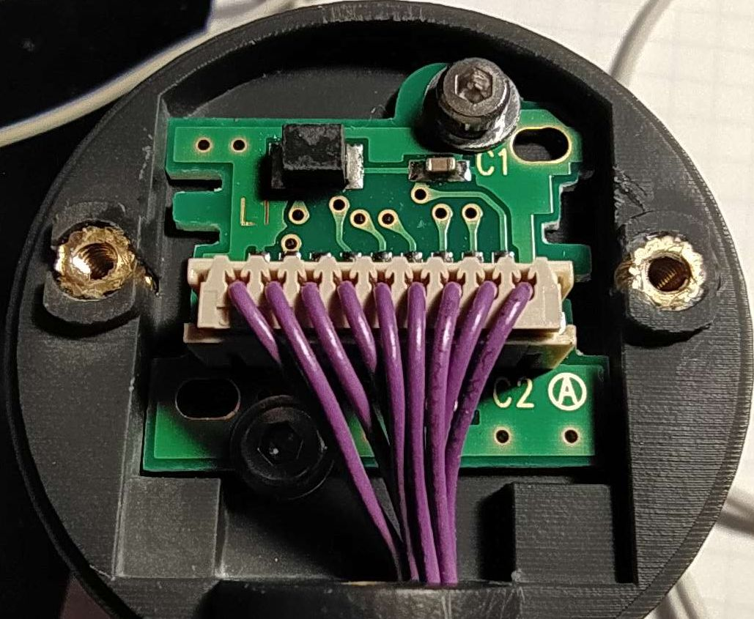
CAM_VCC
CAM_START
CAM_SIN
CAM_LOAD
CAM_RESET
CAM_CLOCK
CAM_READ
CAM_VOUT
CAM_GND

Slide 7
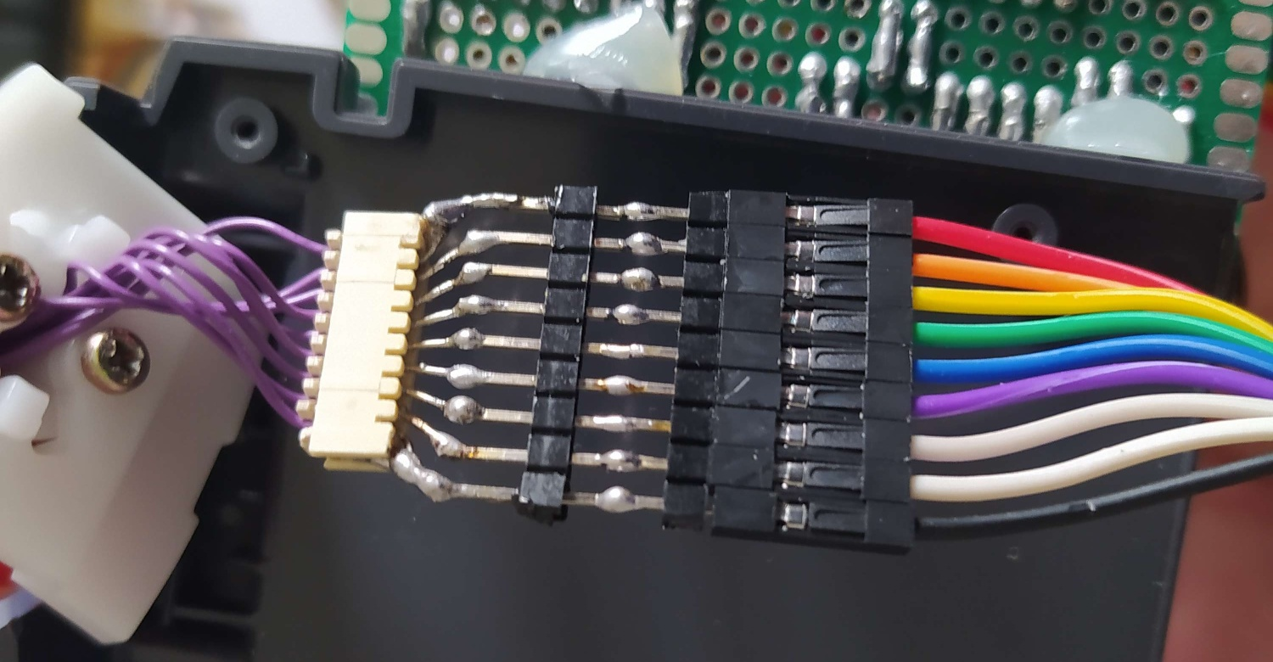
CAM_VCC
CAM_START
CAM_SIN
CAM_LOAD
CAM_RESET
CAM_CLOCK
CAM_READ
CAM_VOUT
CAM_GND
Side with prongs
on connector

Slide 8
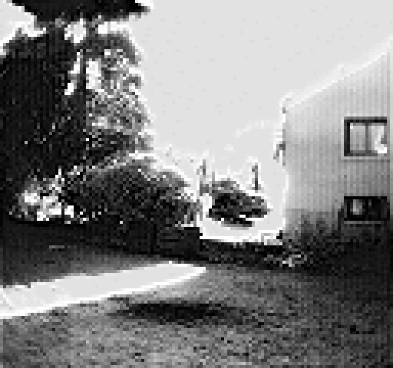
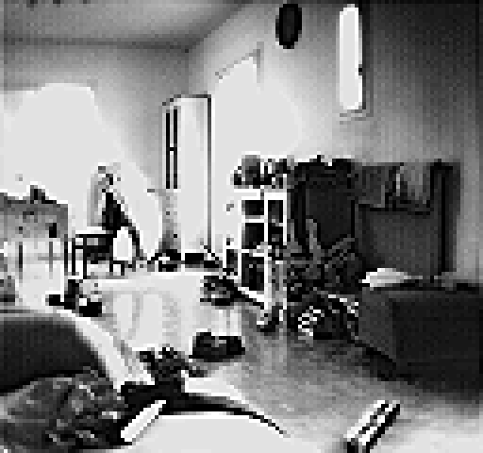
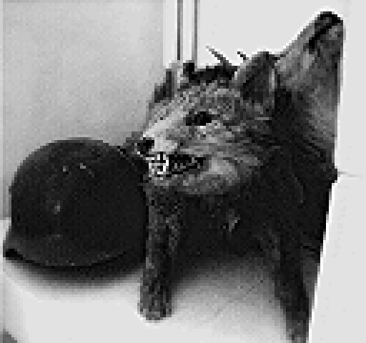
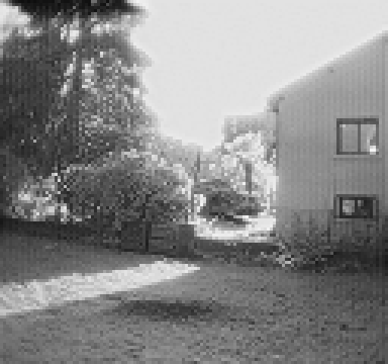
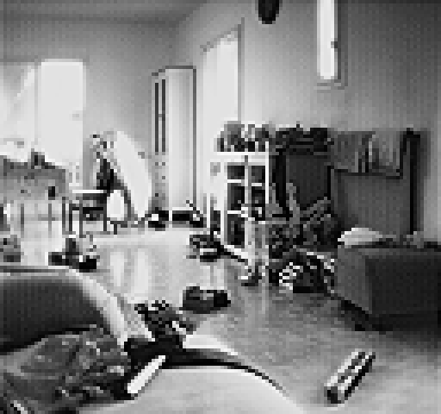
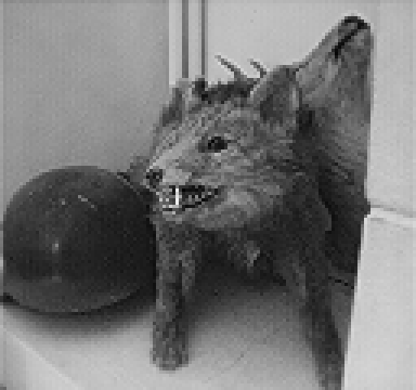
Images taken in normal mode
Images taken in High Definition Range mode

